Slide 1
Street Fighter 1½
TEAM METAL SQUAD
Tarana Chowdhury
Igor dePaula
Dung Pham
Alexis Weaver

Slide 2
Goal & Motivation
What did we set out to accomplish, and why?

Slide 3
Goal:
To create a stripped-down, two-player version of the iconic Street Fighter II arcade game.
Notes:
We want to recreate the game system to emulate the gaming experience

Slide 4

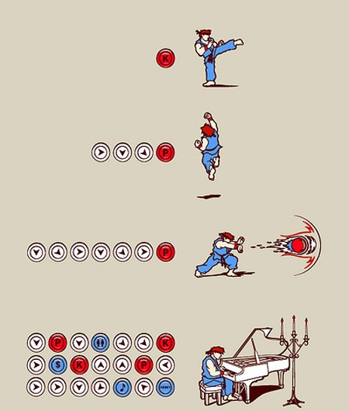
Motivation
Challenging
Modular
Expandability
Fun!
Notes:
Challenging: We wanted a challenging project where we develop our skills
Modular: Work on the most basic
Expandability: There are so many combos and so many different characters and maps that we would’ve been able to keep adding things until we complete everything.

Slide 5
Short Functionality
High-level project overview

Slide 6
High-Level System Block Diagram
Monitor
FPGA
processor.v
VGA
cellular_ram_controller.v
vga_display.v
JAMMA Interface
Joystick 1
Button Cluster 1
Button Cluster 2
Joystick 2
Notes:
“As yall can see, our diagram has changed. We are no longer using the Playstation controllers. Instead we connect the Jamma board to the FPGA. And then the FPGA outputs to the VGA display.

Slide 7
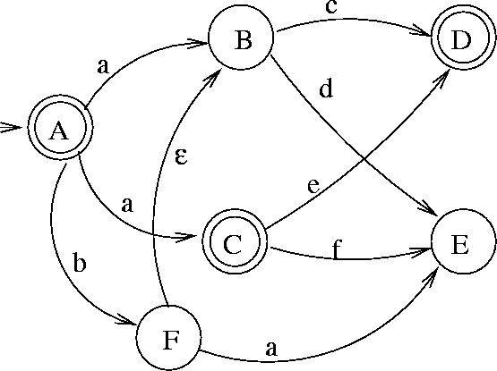
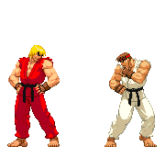
High-Level Gameplay Implementation
vga_display.v
ken:
moves
ryu:
moves
control:
state & move
Notes:
Beneath all of the illustrations and animations, Ken and Ryu are just Finite State Machines. So each character is a finite state machine and every move they can do is also a finite state machine that cycles through different images. Depending on the move and character we request a particular part of the image from memory.

Slide 8
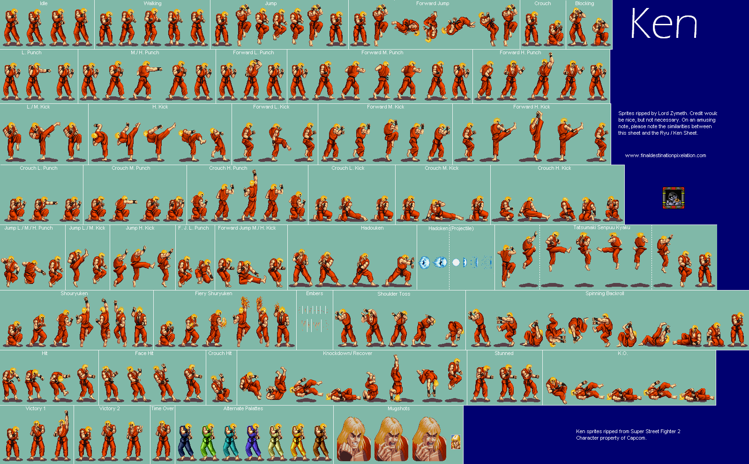
Sprite Sheets and Memory
194 KB
We used the following techniques to load the sprite sheets onto the FPGA:
.png .coe (6 MB) IP Core BRAM (max. ~576 Kbit)
.png .bin (1 MB) Adept DRAM (max. ~128Mbit)
Notes:
Ken - 194 KB
Ryu - 198 KB

Slide 9
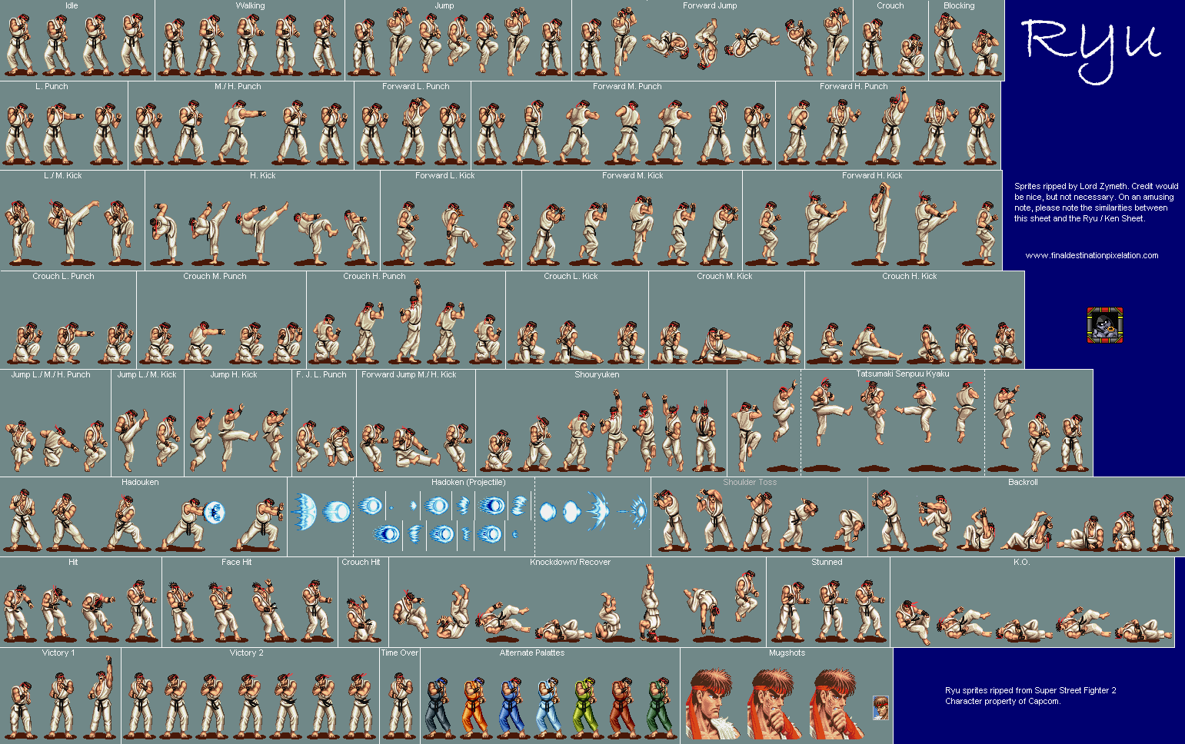
Sprite Sheets and Memory
198 KB
We used the following techniques to load the sprite sheets onto the FPGA:
.png .coe (6 MB) IP Core BRAM (max. ~576 Kbit)
.png .bin (1 MB) Adept DRAM (max. ~128Mbit)
Notes:
Ken - 194 KB
Ryu - 198 KB

Slide 10


Sprite Sheets and Memory
+
We used the following techniques to load the sprite sheets onto the FPGA:
.png .coe (6 MB) IP Core BRAM (max. ~576 Kbit)
.png .bin (1 MB) Adept DRAM (max. ~128Mbit)
Notes:
Ken - 194 KB
Ryu - 198 KB

Slide 11
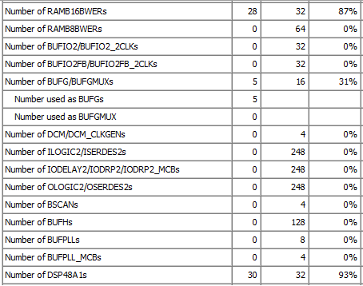
Device Utilization

Slide 12
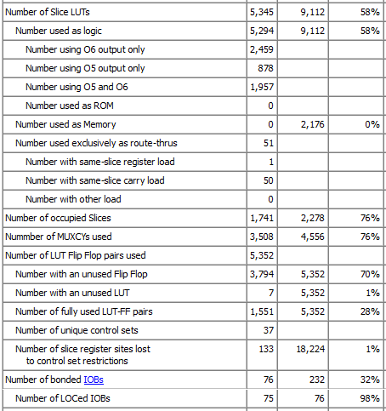
Device Utilization

Slide 13
Short Specification
What were the project requirements?

Slide 14
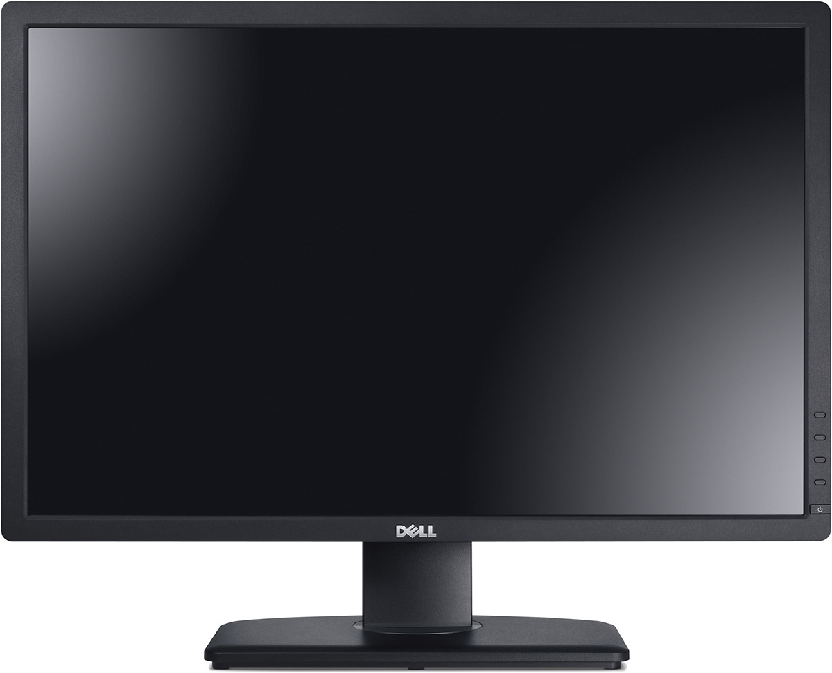
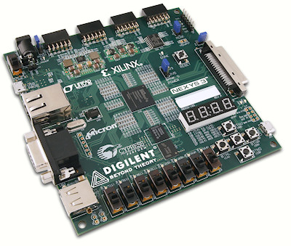
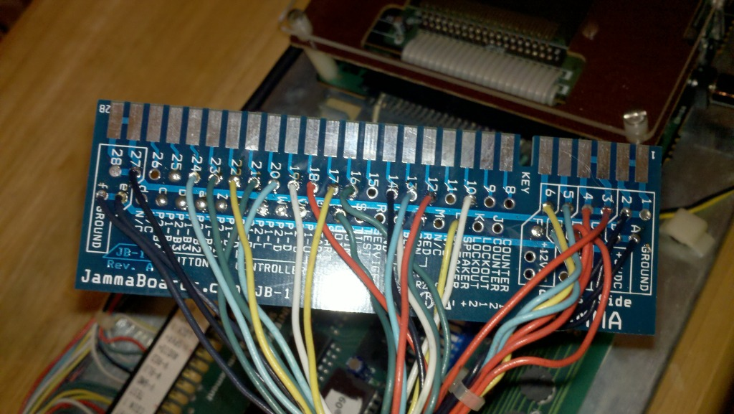
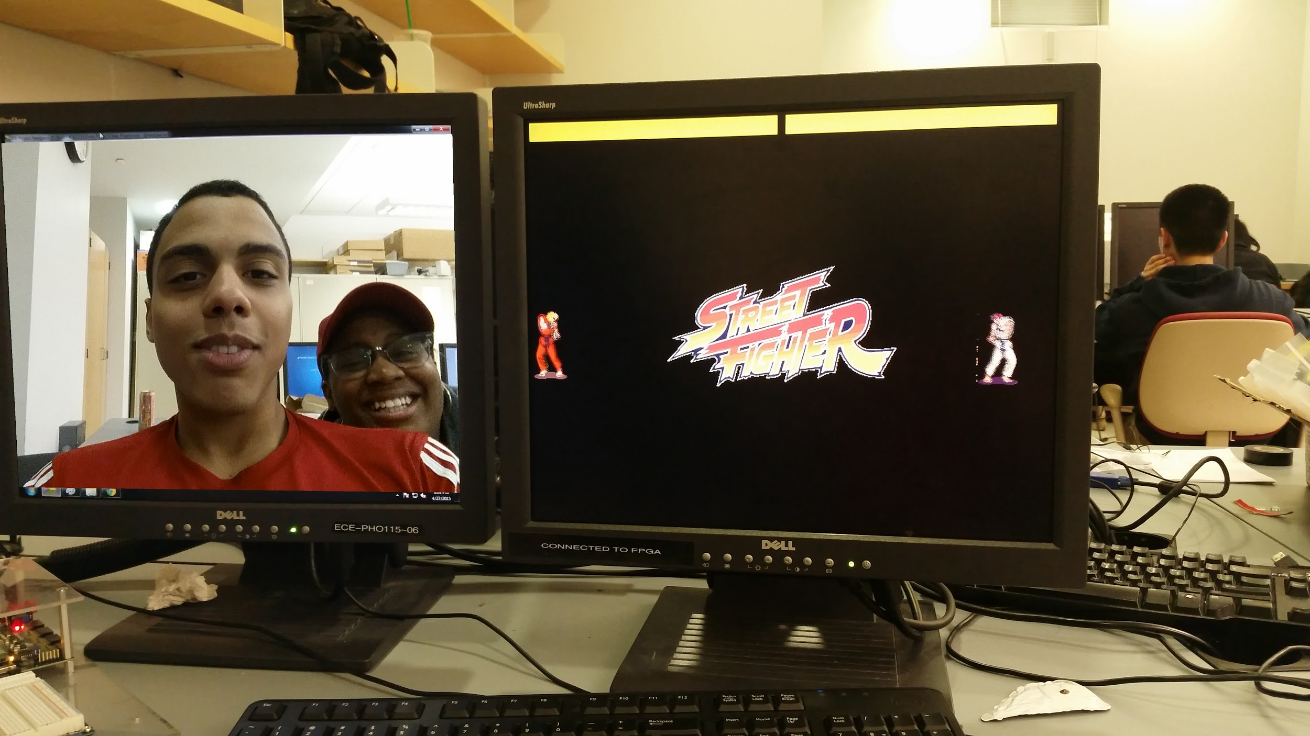
Project Requirements
VGA Display
Nexys 3 Spartan 6 FPGA
JAMMA control interface
Notes:
JAMMA
VGA
Nexys 3 - Spartan 6

Slide 15
Detailed Functionality
Low-level project details

Slide 16
Detailed System Block Diagram
FPGA
Registers: stores current status of game
location (horizontal and vertical)
health (point system)
move
start, pause, knocked out
Move of Ken and Move Ryu as FSM
State of Ken and Ryu as FSM (includes collision detection)
Memory Address Calculation
Logic for VGA display output
processor.v
cellular_ram_controller.v
vga_display.v

Slide 17
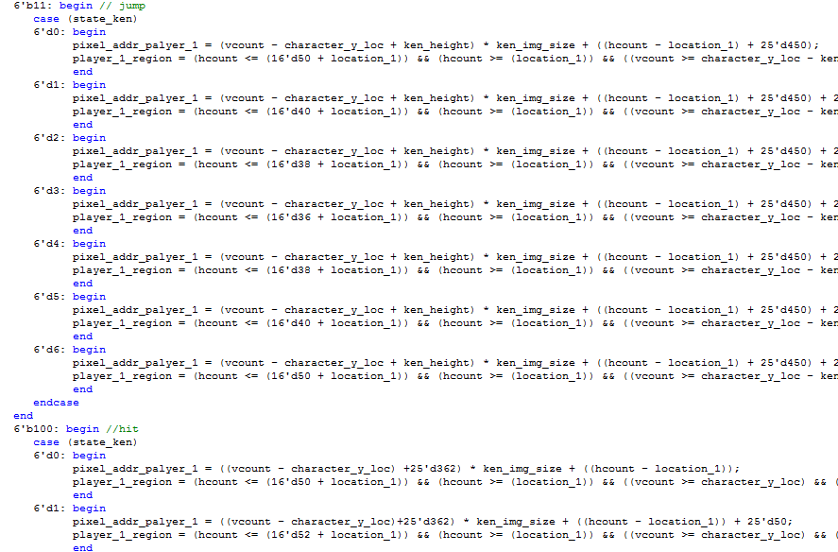
Verilog Code Snippet - Ken Jump

Slide 18
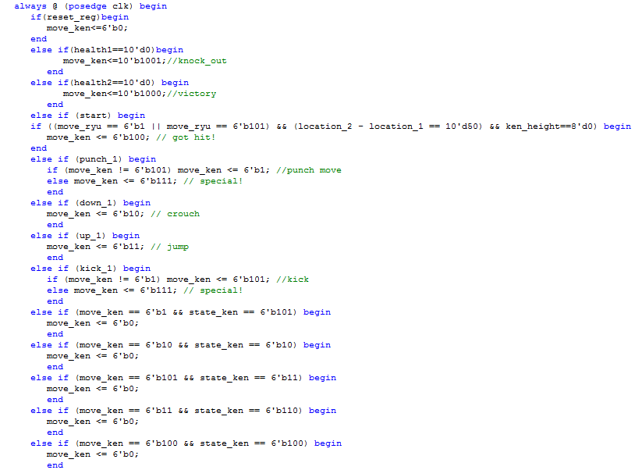
Verilog Code
Snippet
Logic to switch between different moves (Ken)

Slide 19

PRIDE & JOY
The Verilog code we are most proud of.

Slide 20
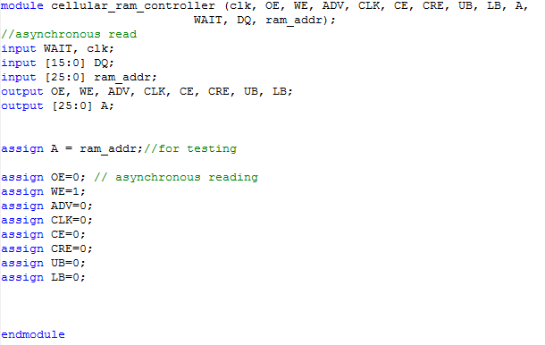
Verilog Code
Snippet - DRAM Controller

Slide 21
Success Analysis
How and why our project is successful.

Slide 22

The Game SUCCESS
Players:
Ryu
Ken
Moves
Idle
Jump
Crouch
Kick*
Punch
Special (different for each character)
Victory
Knockout
Illustrations
Street Fighter Logo
KO
Health Bars
*Ken has an additional punch, instead of kick.

Slide 23
Failure Analysis
What didn’t go as planned.

Slide 24

The Game failures
Features that were planned, but did not make the final cut:
Only two characters
No midi music
No character select
No game maps
Not all moves implements
*All these obstacles are due to limited on-board memory

Slide 25
Remaining Work
What’s left to be done.

Slide 26
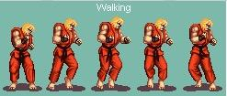
Finishing Touches
Implement walking for each player
Add ability to reset/restart gameplay
Clean-up noisy images
Notes:
JAMMA
VGA
Nexys 3 - Spartan 6

Slide 27
Thanks!

